Slide 1
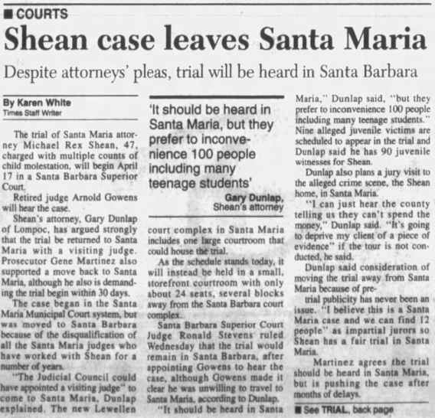
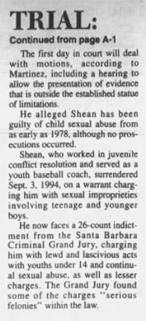
Santa Maria Times
April 7, 1995

Slide 2
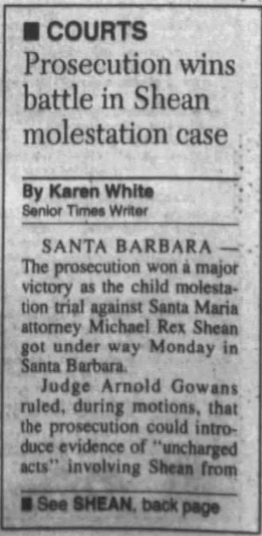
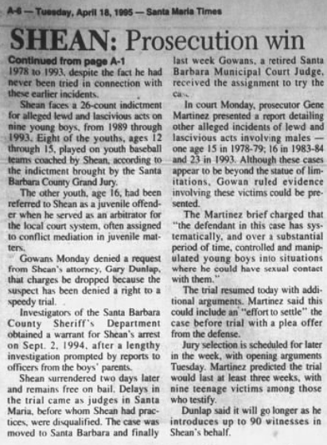
Santa Maria Times
April 18, 1995

Slide 3
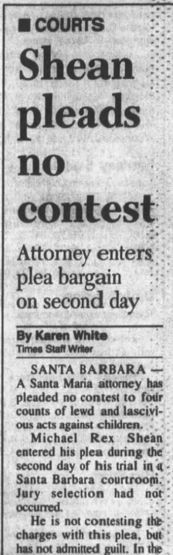
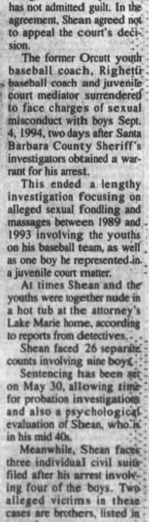
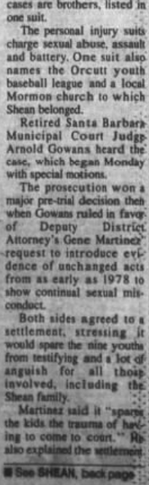
Santa Maria Times
April 19, 1995
Page 1

Slide 4
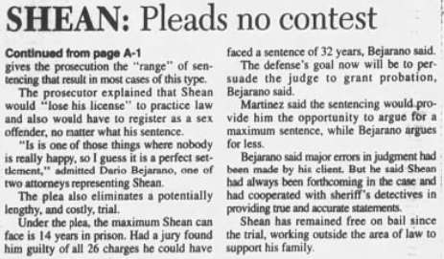
Santa Maria Times
April 19, 1995
Page 2

Slide 5
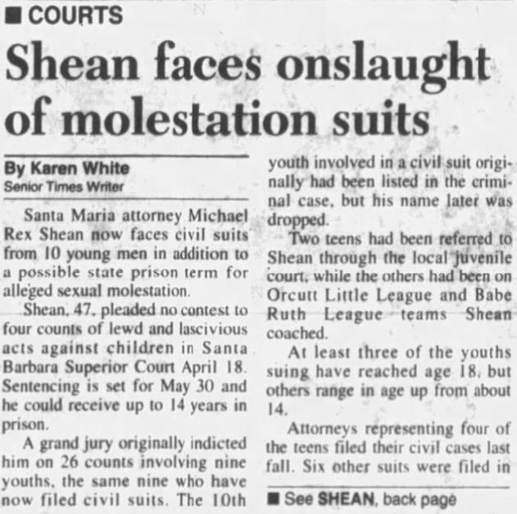
Santa Maria Times
April 25, 1995
Page 1

Slide 6
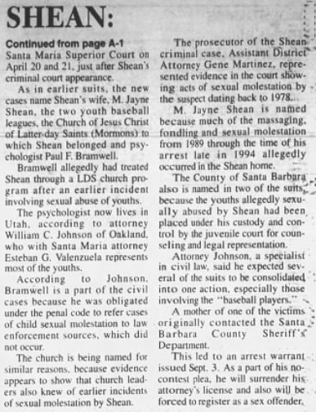
Santa Maria Times
April 25, 1995
Page 2

Slide 7
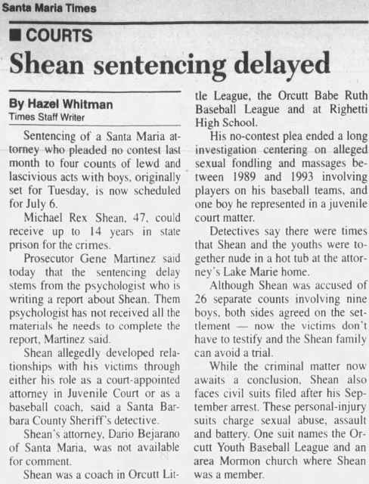
Santa Maria Times
May 31, 1995

Slide 8
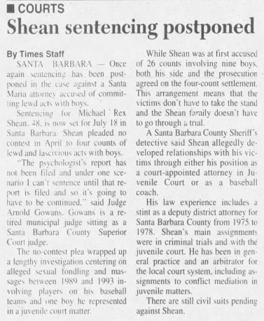
Santa Maria Times
July 6, 1995

Slide 9
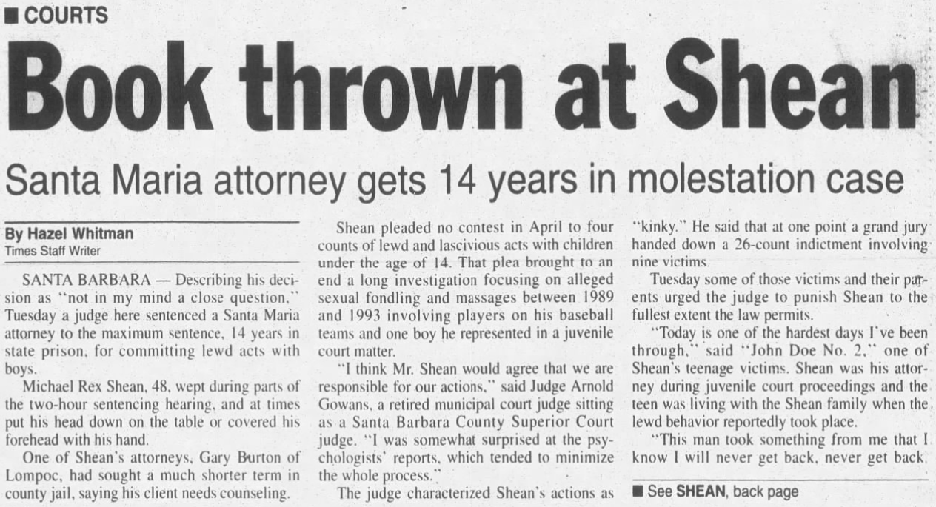
Santa Maria Times
July 19, 1995
Page 1

Slide 10
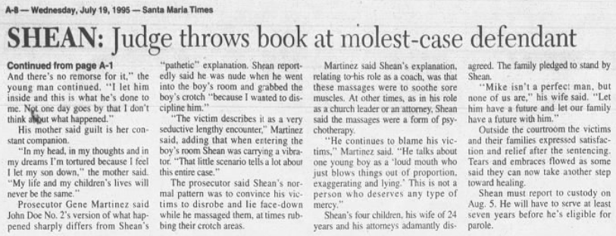
Santa Maria Times
July 19, 1995
Page 2

Slide 11
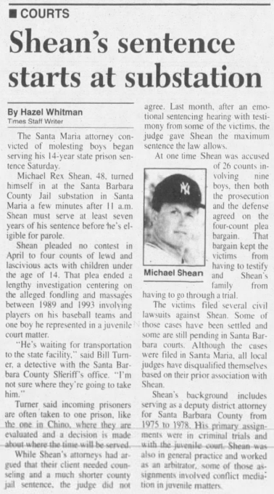
Santa Maria Times
August 7, 1995

Slide 12
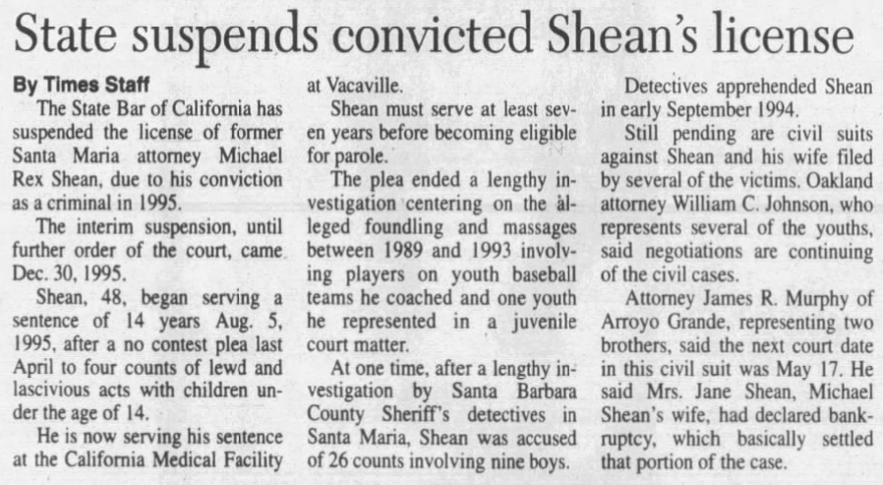
Santa Maria Times
January 19, 1996

Slide 13
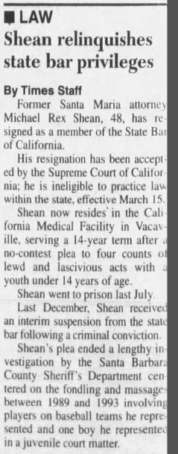
Santa Maria Times
March 19, 1996

